Slide 1
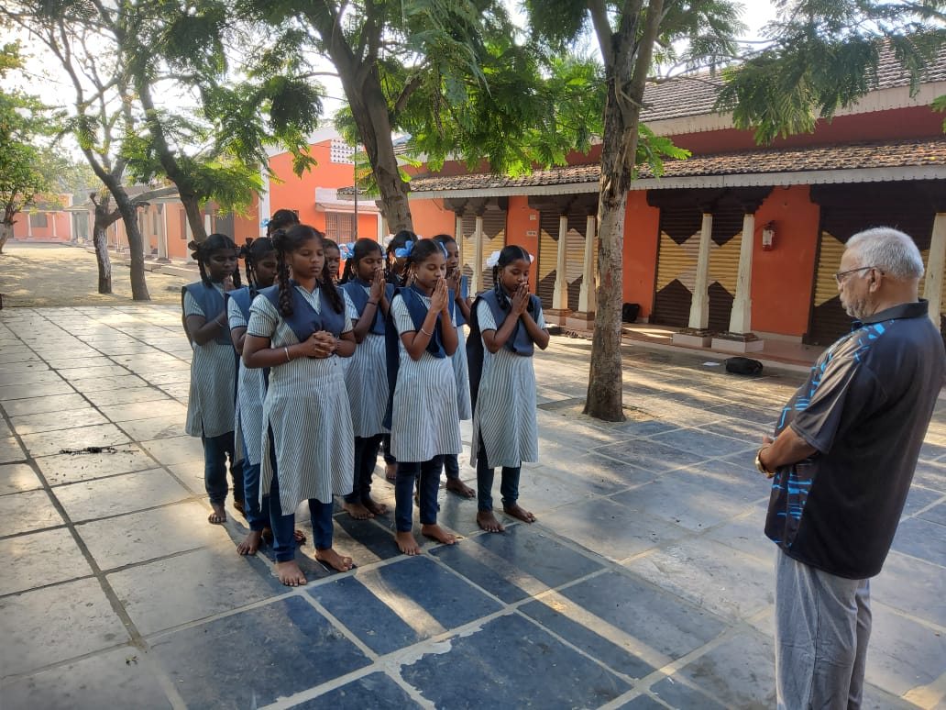
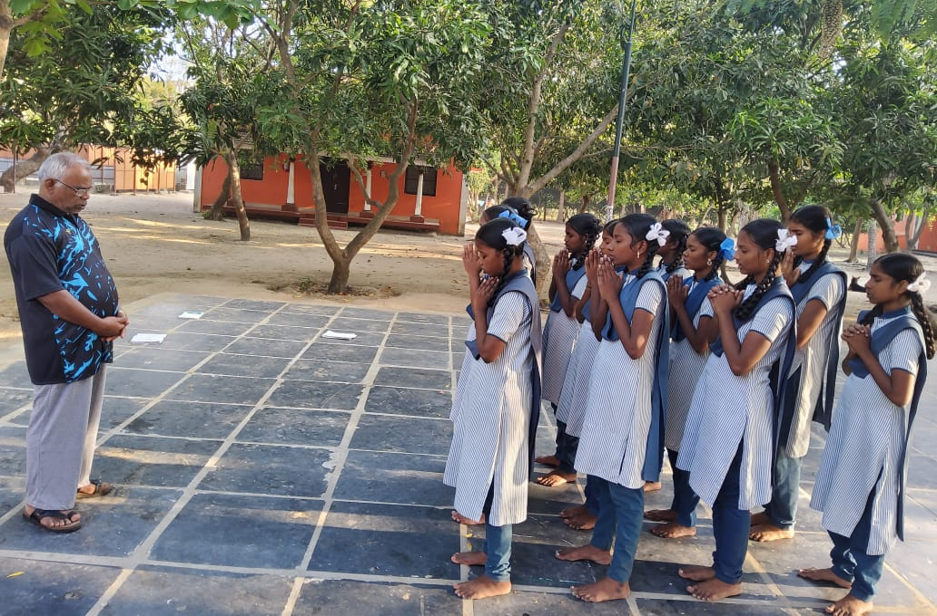
Pudhuirudayam orphanage children praying for the success before going to write their annual exam

Slide 2
Pudhuirudayam orphanage children Getting blessing from the executive director dr. I. Sebastian

Slide 3
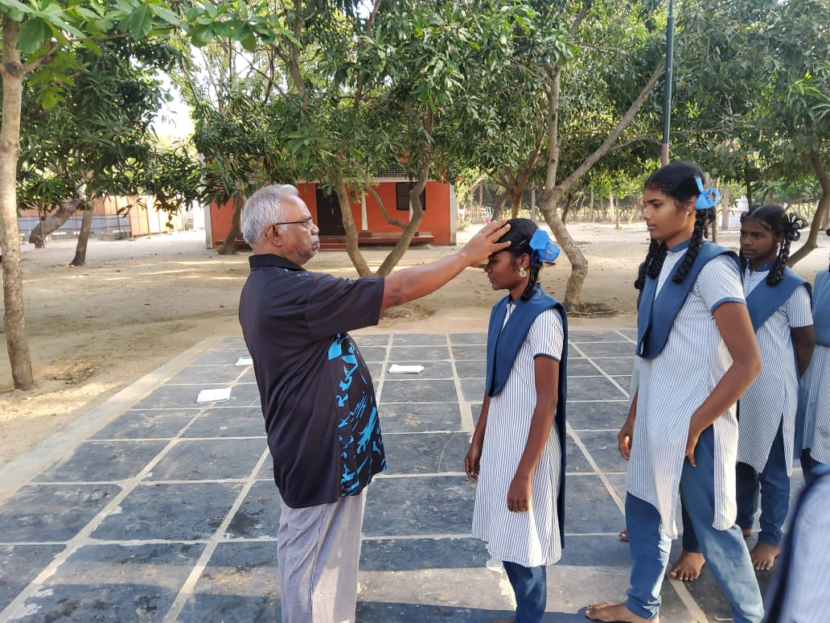
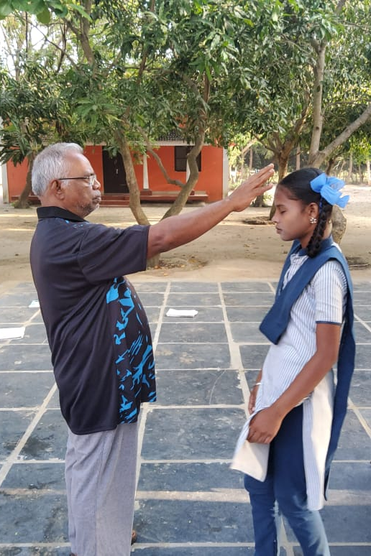
Continued…

Slide 4
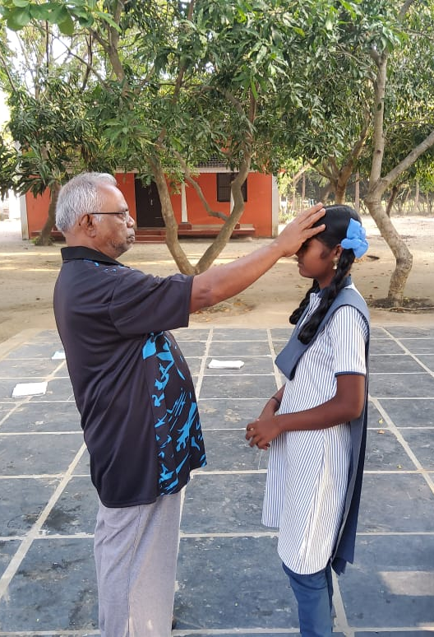
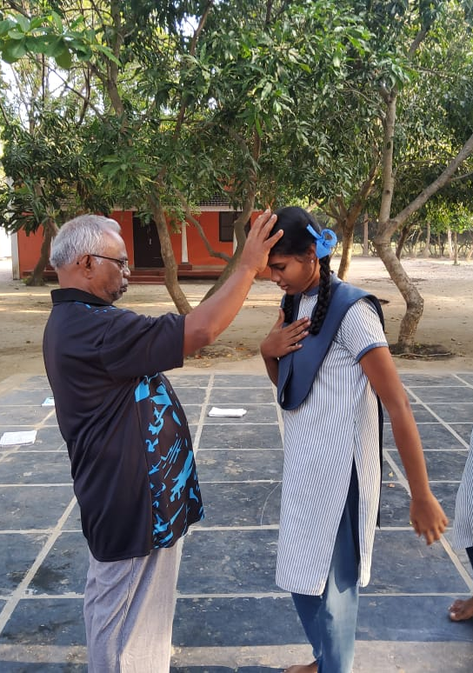
Continued…

Slide 5
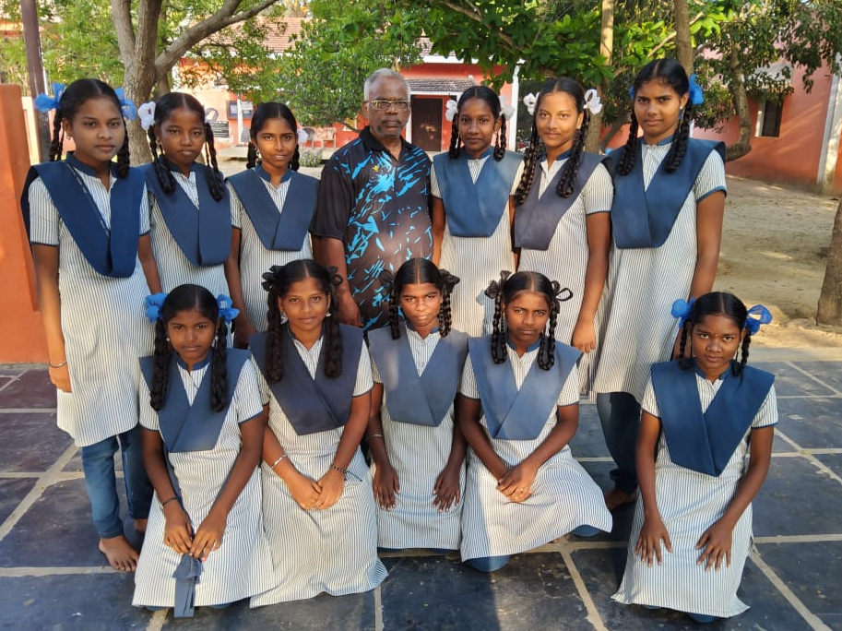

Slide 6
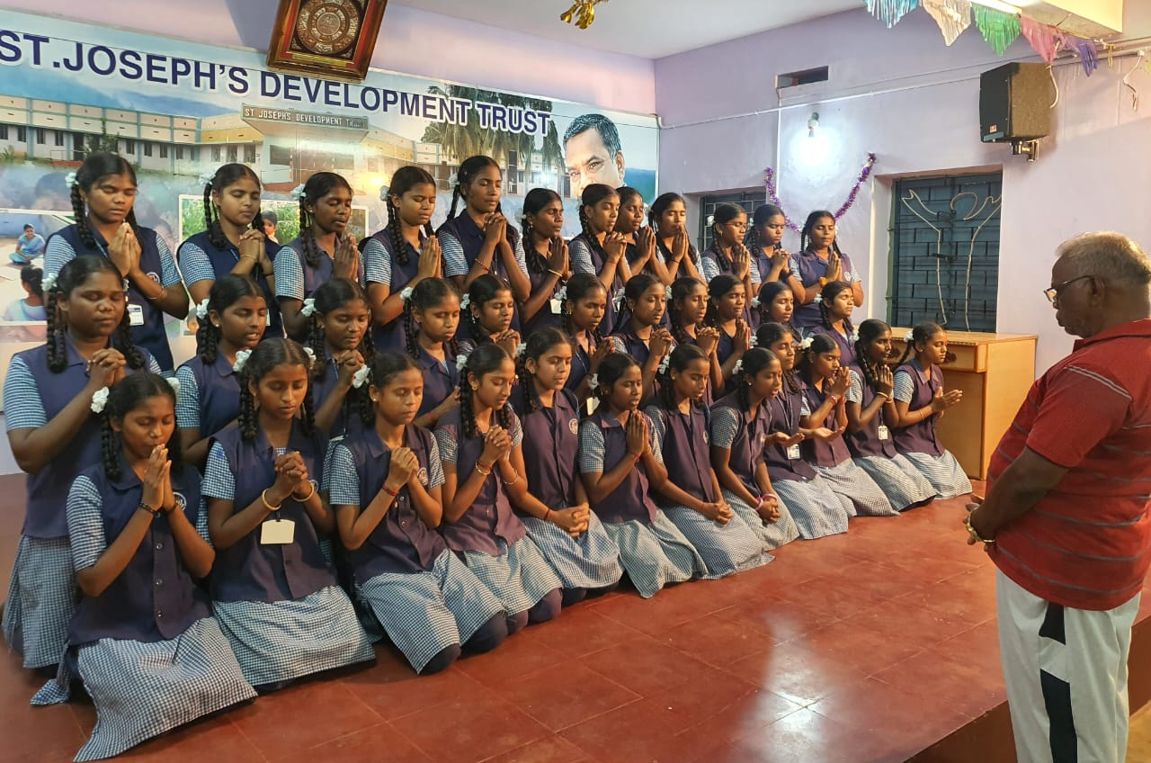
Pudhupunal orphanage children praying for the success before going to write their annual exam

Slide 7
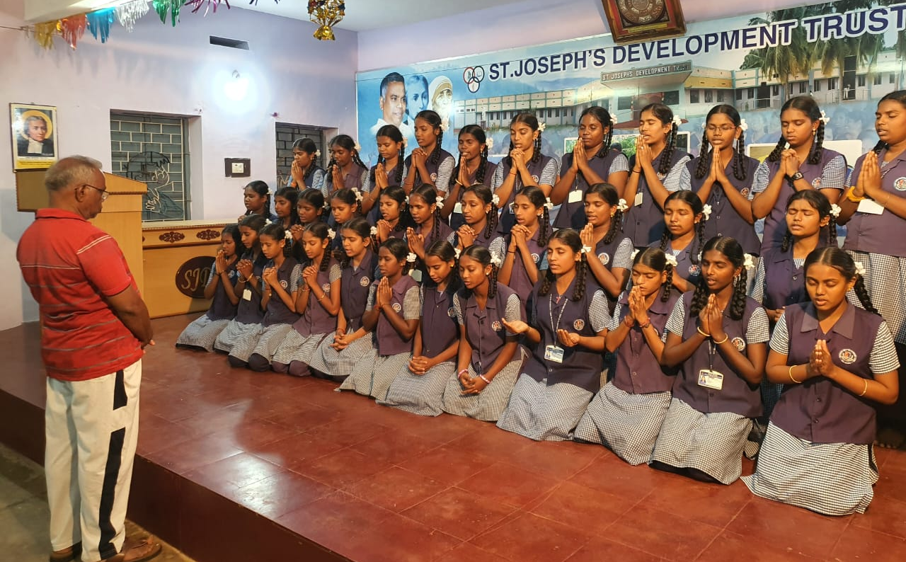
Continued…

Slide 8
PUDHUPUNAL ORPHANAGE CHILDREN GETTING BLESSING FROM THE EXECUTIVE DIRECTOR DR. I. SEBASTIAN

Slide 9
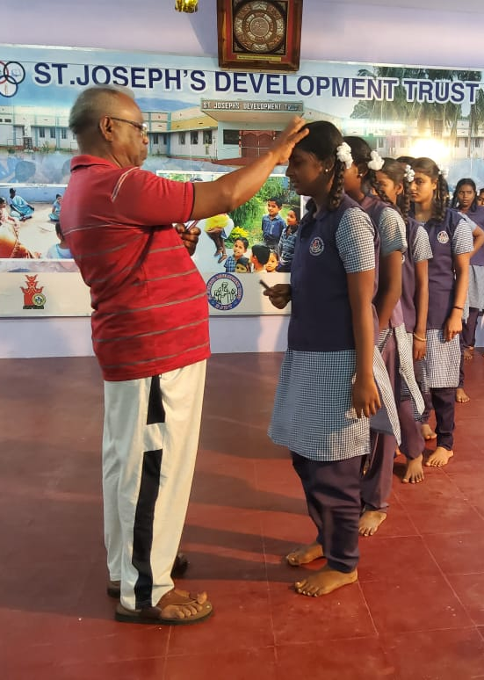
Continued…

Slide 10
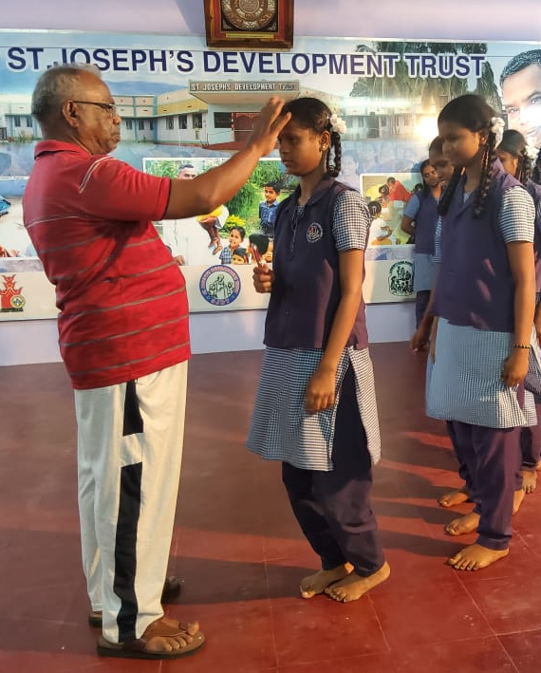
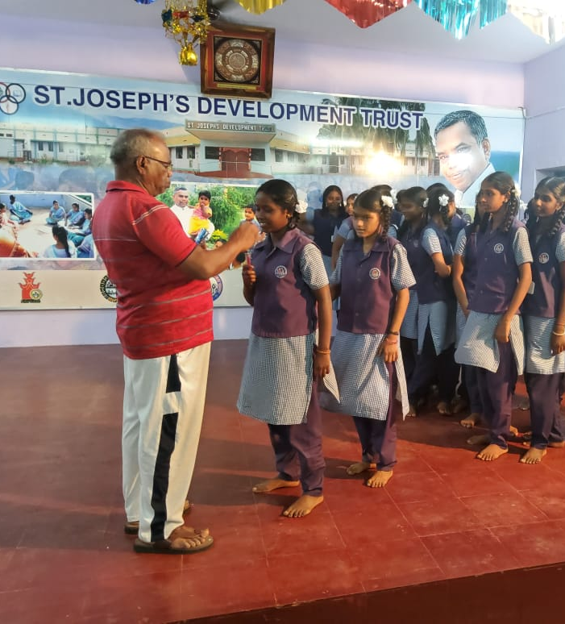
Continued…

Slide 12
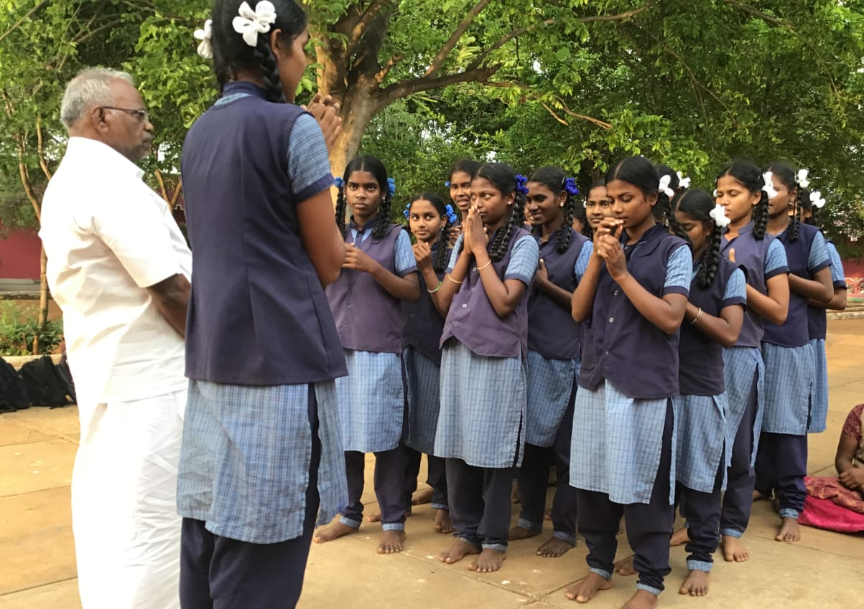
Pudhuvasantham orphanage children praying for the success before going to write their annual exam

Slide 13
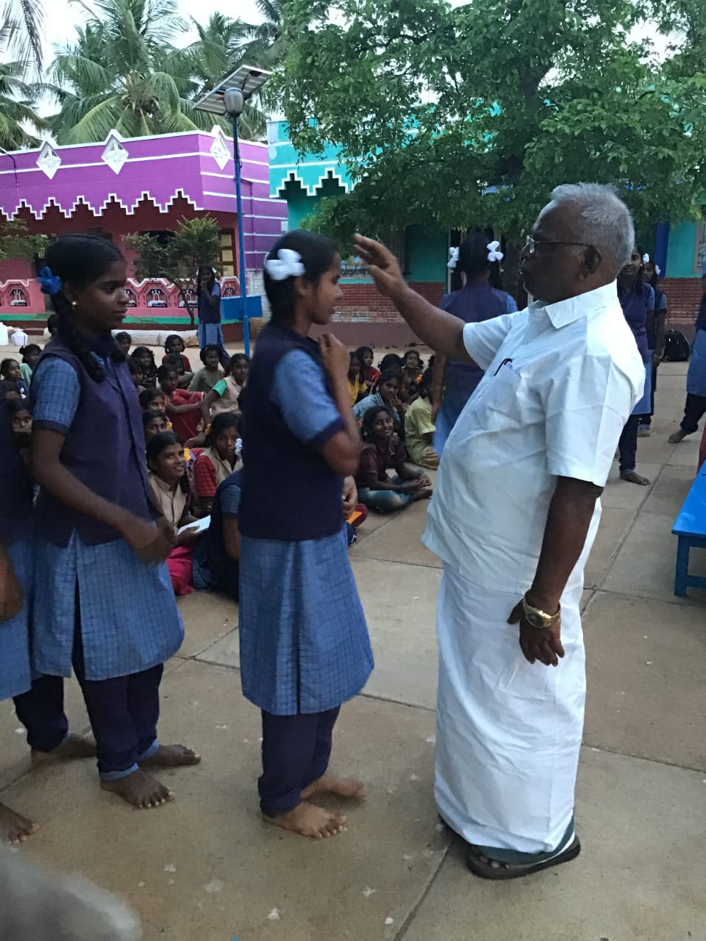
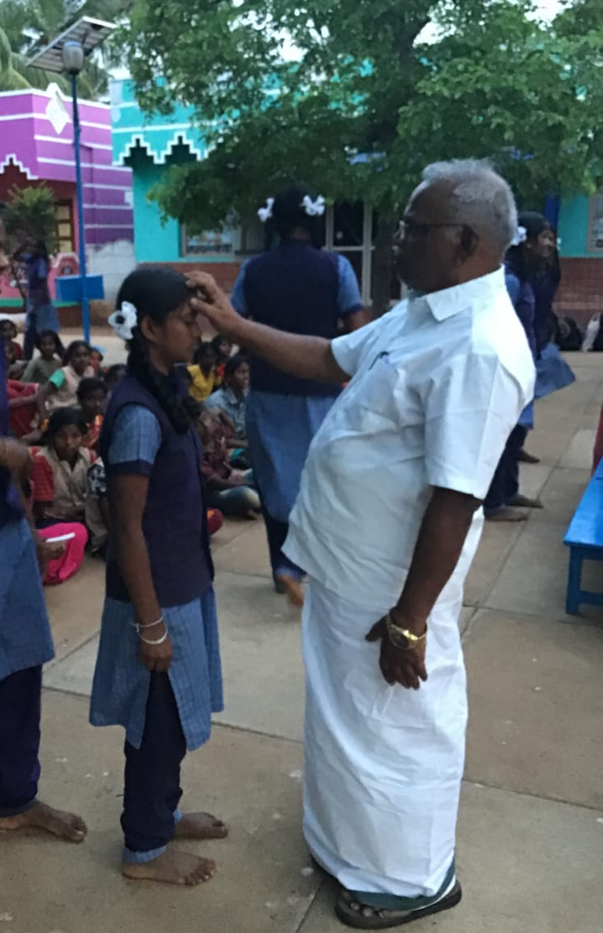
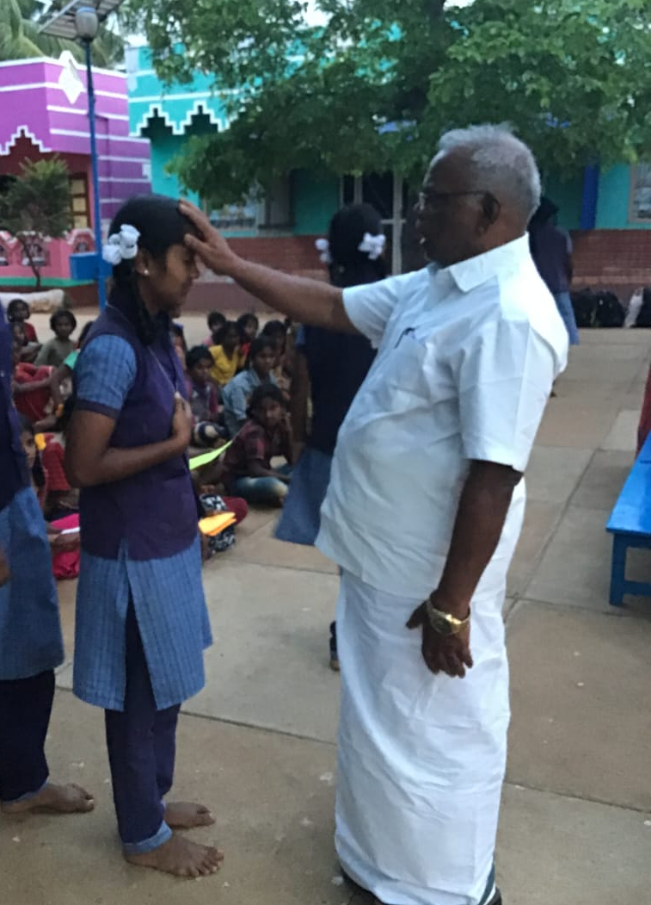
PUDHuvasantham ORPHANAGE CHILDREN GETTING BLESSING FROM THE EXECUTIVE DIRECTOR DR. I. SEBASTIAN

Slide 14
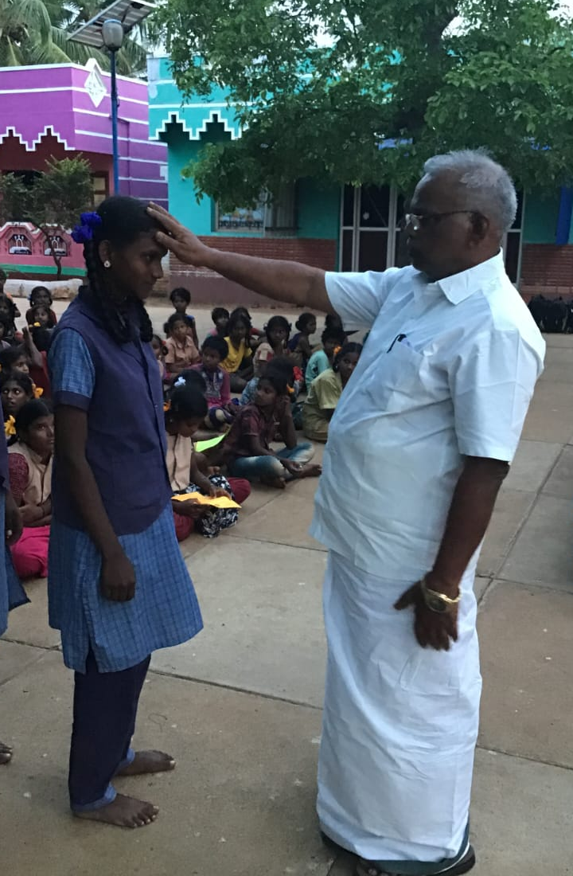
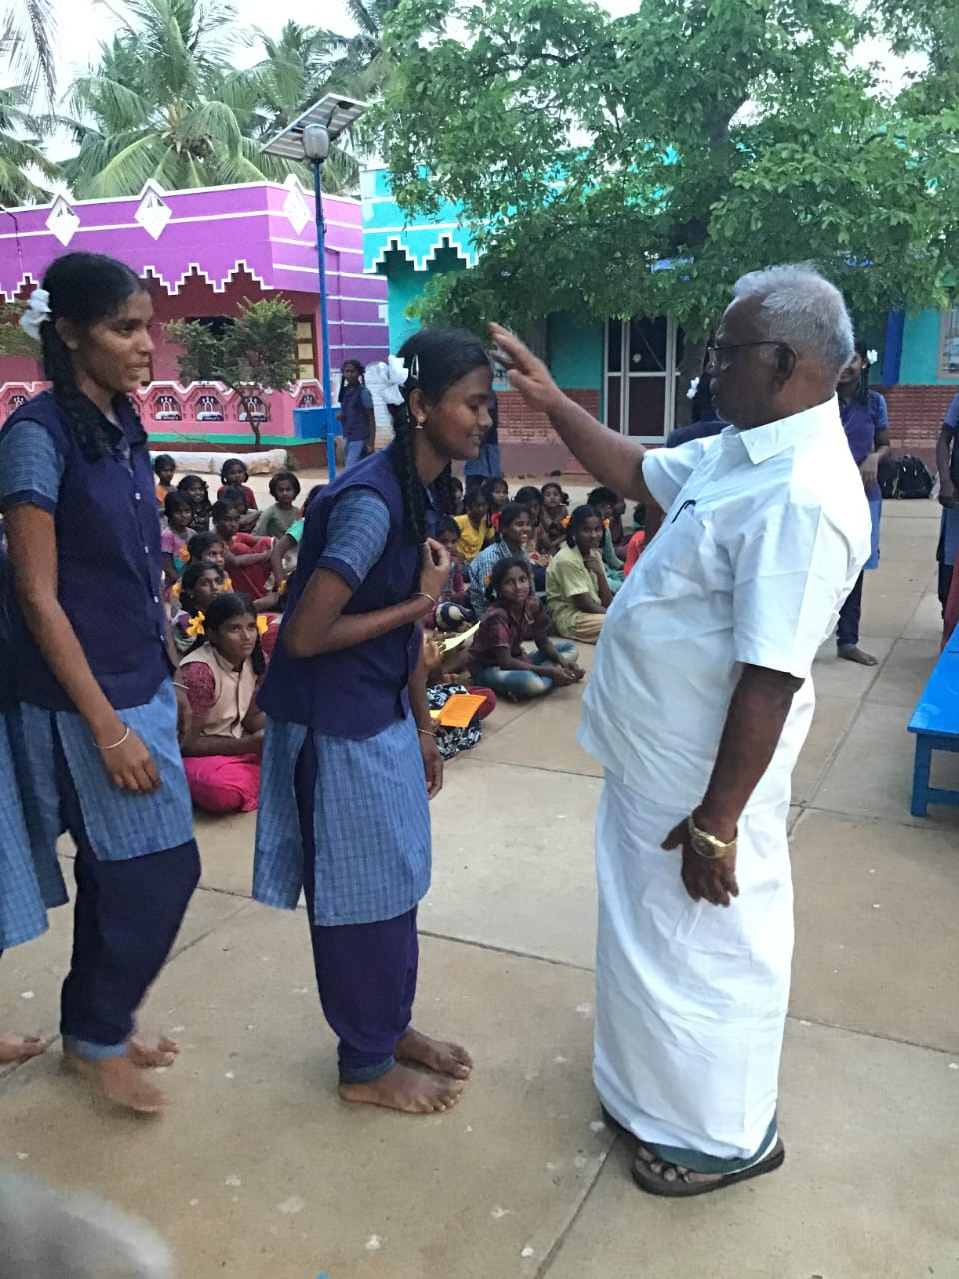
Continued…

